Slide 1
Novel Method for VITAMIN DEFECIENCY DETECTION USING ALEXNET DNN Algorithm

Slide 2
ABSTRACT
In this project, we propose an intelligent system to detect and distinguish Vitamin Deficiency from Human Tissue by deep learning techniques.
At first, image clustering into segment out the lesion.
Our aim is to test the effectiveness of the proposed segmentation technique, extract the most suitable features, and compare the classification results with the other techniques
Deep neural network is utilized for the classification of Stomach cancer Images.

Slide 3
INTRODUCTION
Vitamin D is an essential vitamin that has powerful influence on several parts of the human body.
Nearly one billion people highly suffered from Vitamin D Deficiency across the globe.
Vitamin D Deficiency is associated with several auto immune disorders like cardiovascular disease, diabetes mellitus and breast cancer.
Though, the enormous amount of data is collected every day in the medical field, processing of the large datasets will be challenging with the traditional approaches and recent studies proved that applying machine learning models will yield better results.

Slide 4
Segmentation Algorithm
Process of partitioning a digital image into multiple segments.
Used to find the location of lesion border.
Existing algorithms are only applicable to dermoscopy images.
Digital photographs cant be used with existing algorithms because of illumination variation.
Segmentation based on pixel color intensity.

Slide 5
Existing System
Human based systems are involved in the Vitamin Deficiency Detection process.
But this type of systems are having reliably issues with man made error chances.
The most commonly used technique SVM is not a straightforward task due to the great variety of Tissues, low contrast between the lesion and the surrounding Stomach, irregular and fuzzy lesion borders Skin Images types and presence of Noise.

Slide 6
PROBLEM DEFINITION
False detection.
SVM operate on images with less amount of contrast.

Slide 7
PROPOSED Solution
In this project, an approach to border detection in Tissue images based on the multi-level decomposition and classification method is presented.
The scope of ALEXNET is used.
Two phases are training and testing Done using Deep Neural Network.

Slide 8
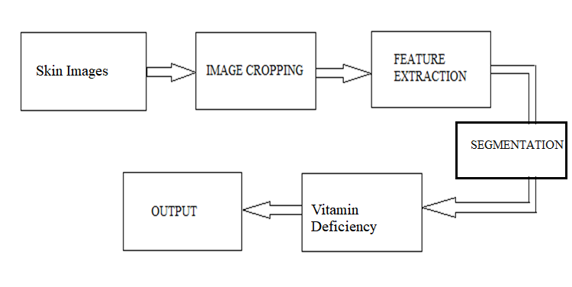
BLOCK DIAGRAM

Slide 9
METHODOLOGY

Slide 10
1.INPUT IMAGES
Special camera called Microscopy camera’
is used for taking images.
An image is made up of a finite no of elements called pixels, each of which has a particular location and values.
Images are represented in the form of matrix in Python.

Slide 11
2.IMAGE CROPPING
Cropping- The process of removing selected pixels from a digital image.
It is done in order to make all the images are of equal sizes.

Slide 12
3.FEATURE EXTRACTION
Images are analyzed to extract features like
Pixel count
Mean
Standard deviation
These features are selected to ensure that between class discrimination is maximum within class discrimination is minimum.

Slide 13
CLASSIFICATION
Classification is done using an ‘Reginal Convolutional neural network’
‘ALEXNET is a mathematical or computational model and consists of an interconnected group of artificial neurons.
Two layer network is developed and training is done to achieve minimum error.

Slide 14
ADVANTAGES
Early detection of Cancer will reduces the complication.
Reduction in significant amount of workload and time for ophthalmologists.
ALEXNET is able to generalize since they are trained by example.

Slide 15
DISADVANTAGES
Limitation in choosing the size of image
Costly implementation

Slide 16
APPLICATIONS
This study can be extended for the analysis of other diseases like hypertension, stroke, migraine, and hearing loss.

Slide 17
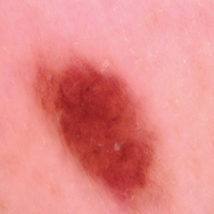
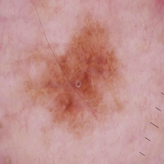
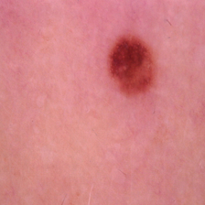
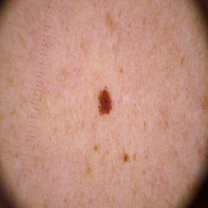
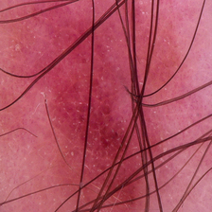
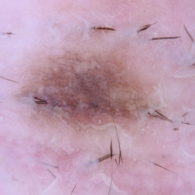
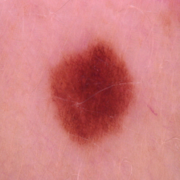
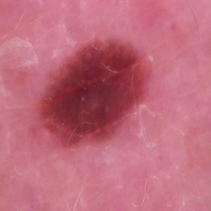
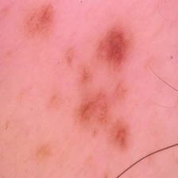
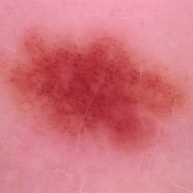
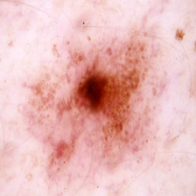
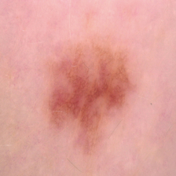
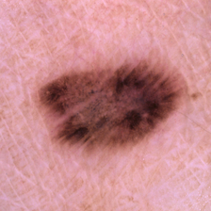
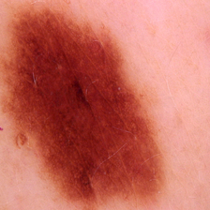
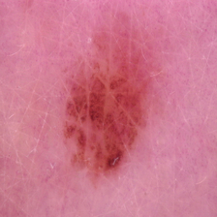
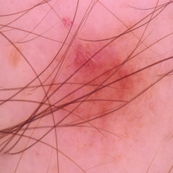
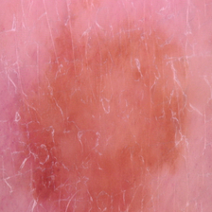
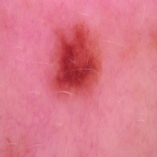
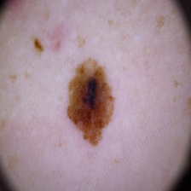
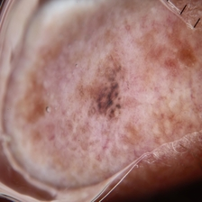
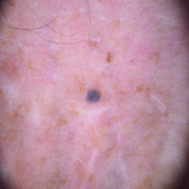
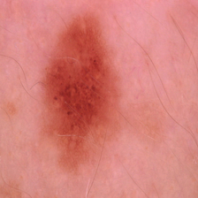
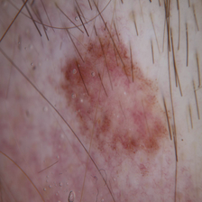
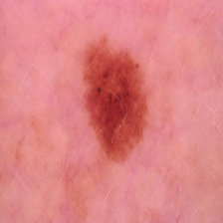
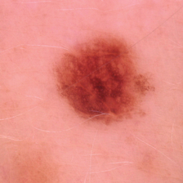
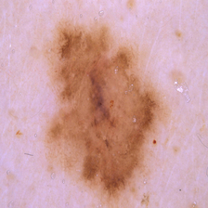
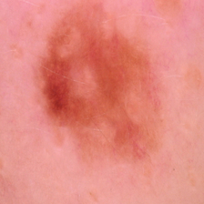
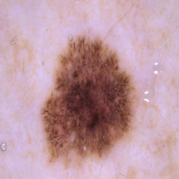
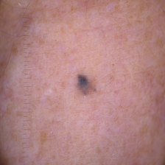
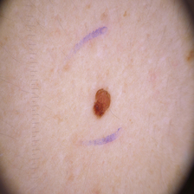
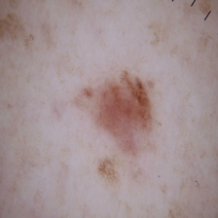
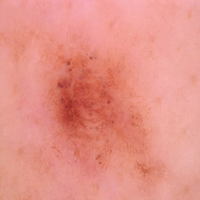
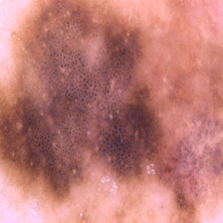
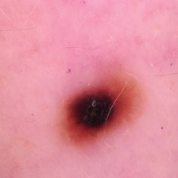
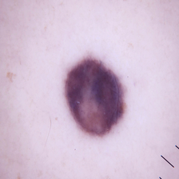
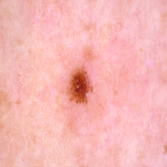
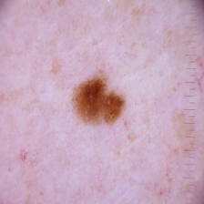
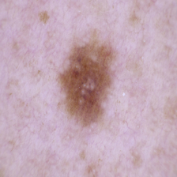
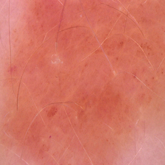
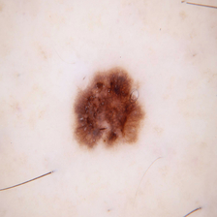
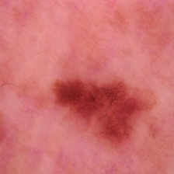
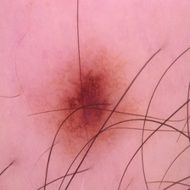
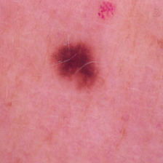
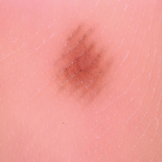
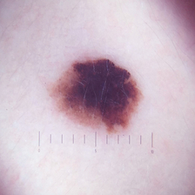
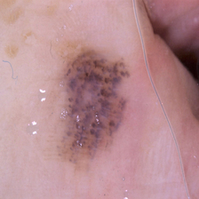
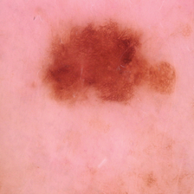
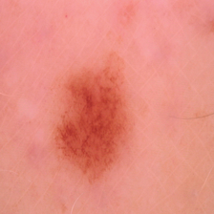
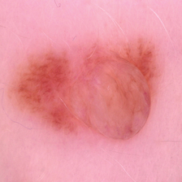





















SAMPLE DAATSET

Slide 18

SCREENSHOT

Slide 19

SCREENSHOT

Slide 20

SCREENSHOT

Slide 21
Conclusion
The objective of our study is to investigate a good method for automated analysis of Skin images for the purpose of detecting and recognizing Vitamin Deficiency diseases.
The proposed method can recognize with accurately, in comparison to other methods and is potentially a powerful tool for the recognition of Vitamin Related diseases.

Slide 22
Thank you

